Slide 1
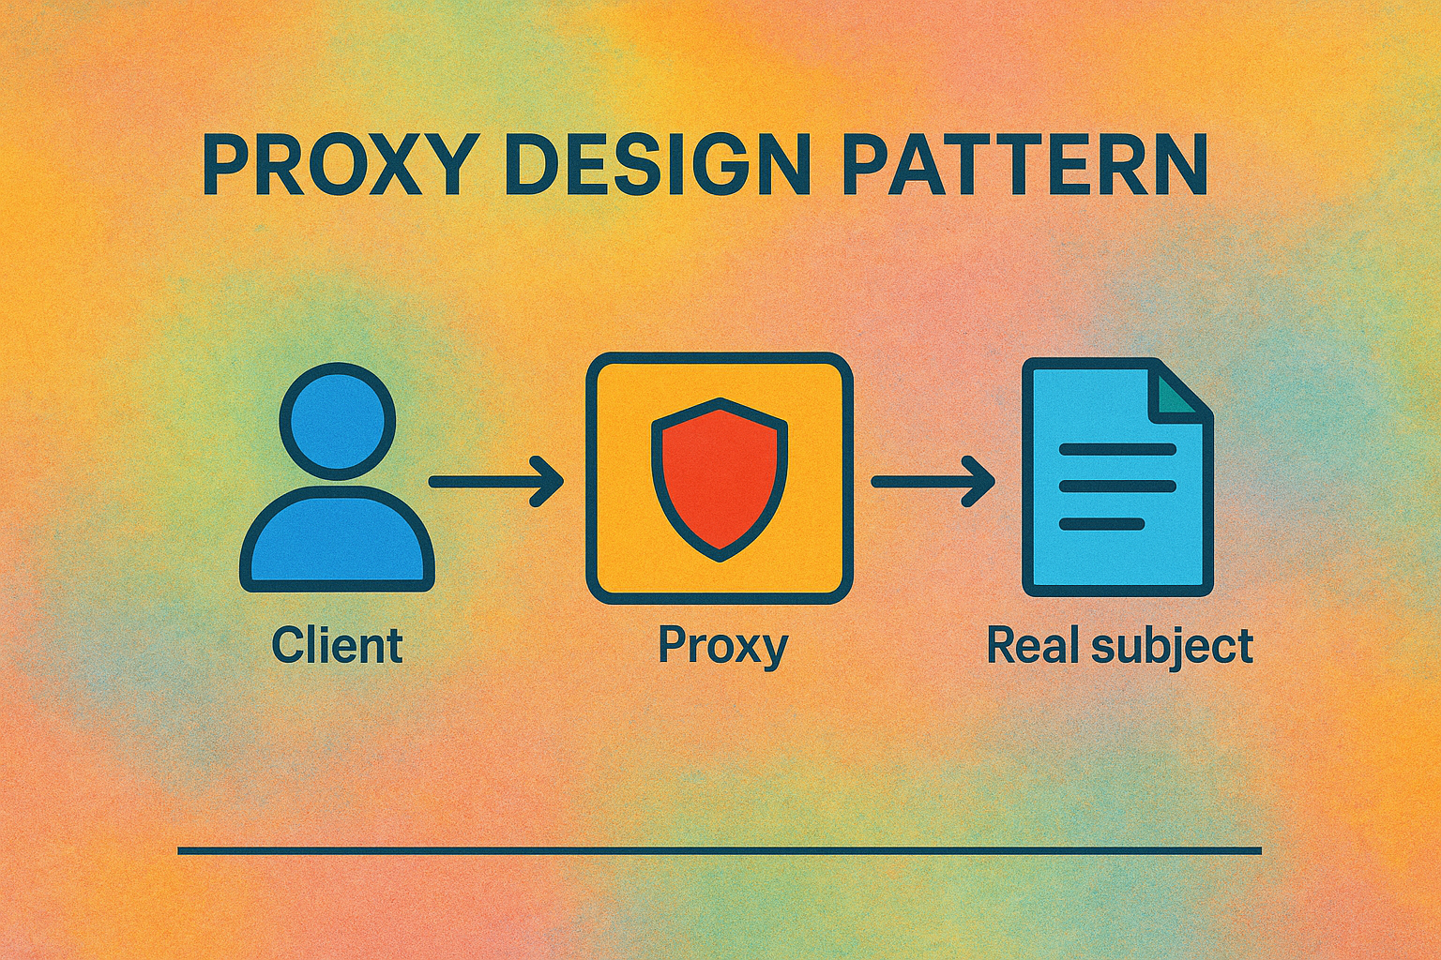

Slide 2
Creational (5)
Factory
Structural (7)
Adapter
Behavioral (11)
Chain Of Responsibility
Abstract Factory
Singleton
Prototype
Builder
Bridge
Composite
Decorator
Facade
Flyweight
Proxy
Command
Interpreter
Iterator
Mediator
Memento
Observer
State
Strategy
Template
Visitor

Slide 3
OOP Principals
Class
Object
Constructors
Inheritance
Method Overriding
Encapsulation
Interfaces
Abstractions
Polymorphism

Slide 4
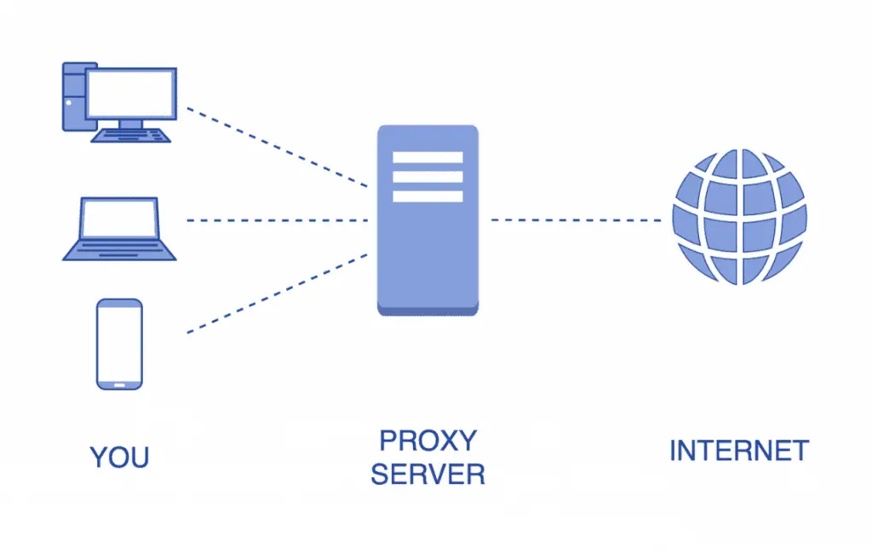

Slide 5
What is a Proxy Server?
A proxy server is an intermediary between a user’s device and the internet.
Key Functions:
1. Anonymity – Hides the client’s IP address
2. Access Control – Blocks or allows content
3. Caching – Speeds up responses & saves bandwidth
4. Security – Filters malicious traffic
5. Bypassing Restrictions – Access blocked/geo-restricted content
Flow: Client → Proxy Server → Destination Server → Proxy Server → Client

Slide 6



Who is a Proxy?

Slide 7
What is Proxy Design Pattern?
This design pattern provides a substitute for another object and controls access to that object, allowing you to perform something before or after the request reaches the original object.
The proxy acts as a simplified or lightweight version of the original object.
A proxy object is still able to accomplish the same tasks.
It but may delegate requests to the original object to achieve them.

Slide 8
Common Scenarios
Virtual Proxy
Resource incentive operations
Lazy Loading
Image Editing
Gaming
Protection Proxy
Authorization of different roles
Users can access only their roles
Data level security
Remote Proxy
Working Remotely

Slide 9
Proxy class should have the same methods as the real class.

Slide 10
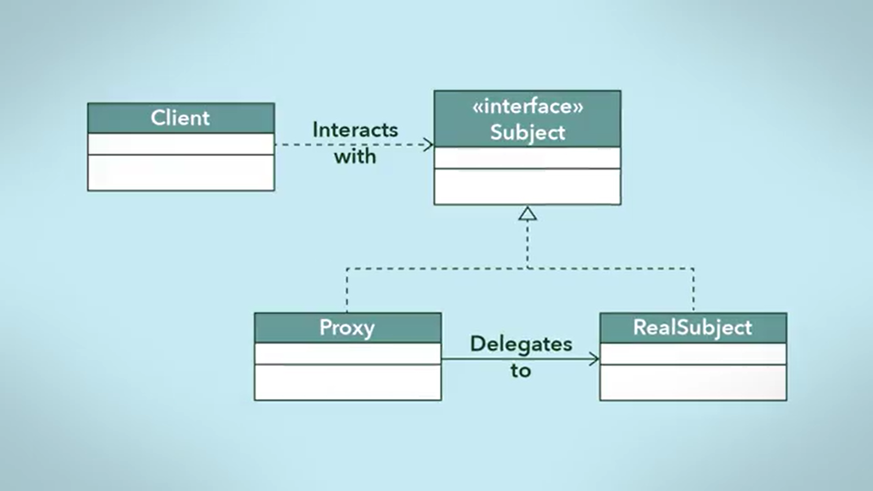

Slide 11
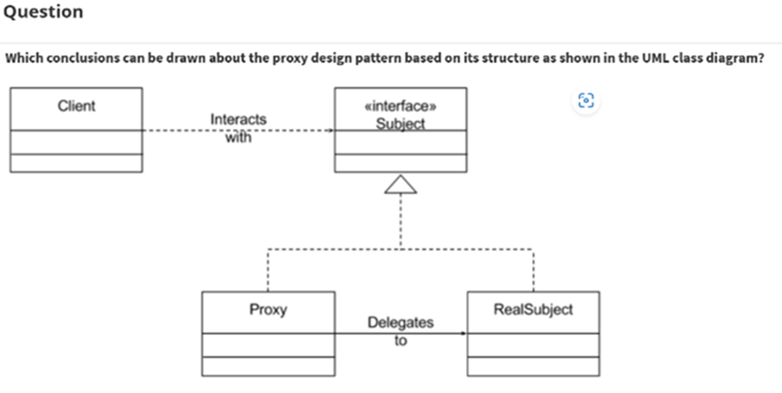

Slide 12
Proxy and RealSubject are subtypes of Subject.
The proxy design pattern achieves polymorphism through implementing a Subject interface.
The RealSubject class knows about the Proxy class, meaning that the RealSubject class has an attribute that refers to an instance of the Proxy class.
The proxy design pattern cannot achieve polymorphism because the Proxy and RealSubject classes are both implementing the Subject.

Slide 13
1. Proxy and RealSubject are subtypes of Subject.
Correct! This is clear from the way interface inheritance is shown with an open arrowhead. Since both Proxy and RealSubject must implement the methods of Subject, they subtypes.
2. The proxy design pattern achieves polymorphism through implementing a Subject interface.
Correct! Polymorphism is achieved with the interface, ensuring that both the Proxy and the RealSubject can be interacted with using the same methods, even if the internal implementation of these methods is different.
3. The RealSubject class knows about the Proxy class, meaning that the RealSubject class has an attribute that refers to an instance of the Proxy class.
4. The proxy design pattern cannot achieve polymorphism because the Proxy and RealSubject classes are both implementing the Subject.

Slide 14
Proxy Design Pattern – Practical Application
Scenario:
  You run an online retail store with global distribution and warehousing.
Problem:
  Orders may be routed to a warehouse without stock.
  Warehouses may receive orders they cannot fulfill.
Solution using Proxy:
  Both Proxy and RealSubject implement the same Subject interface.
  Client interacts with Proxy as if it were the RealSubject.
  Proxy determines stock availability and routes orders to the correct warehouse.
  Ensures orders are only sent to warehouses that can fulfill them.

Slide 15
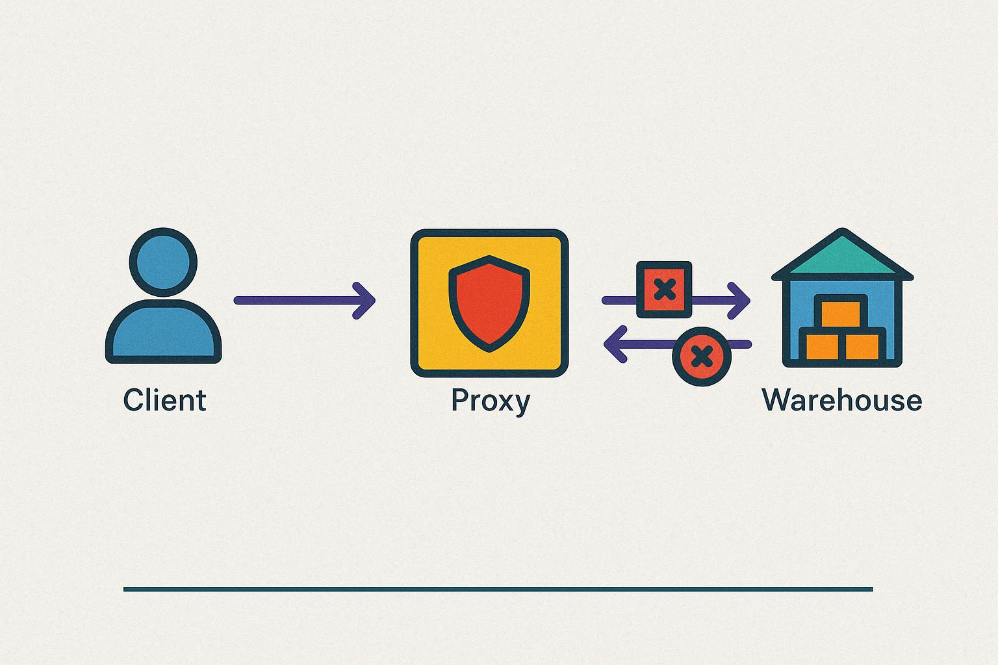

Slide 16
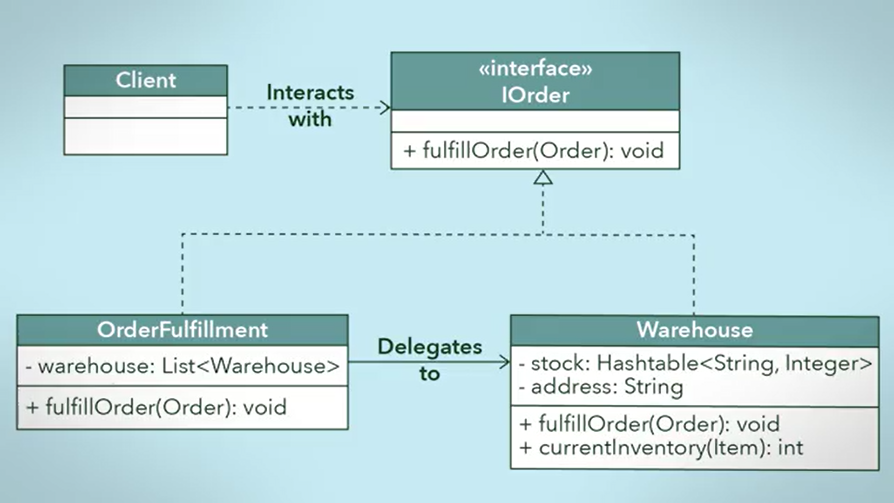

Slide 17
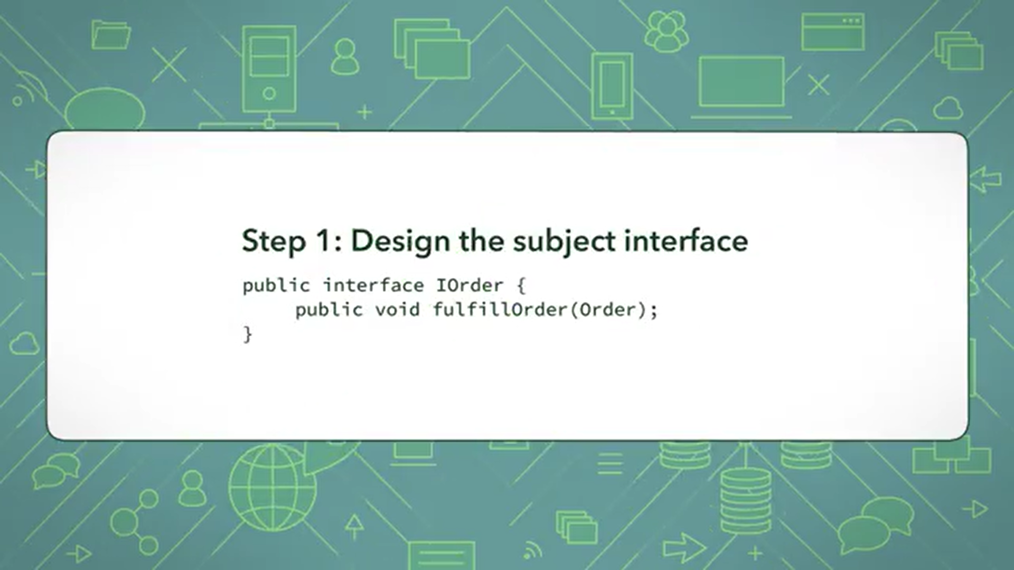

Slide 18
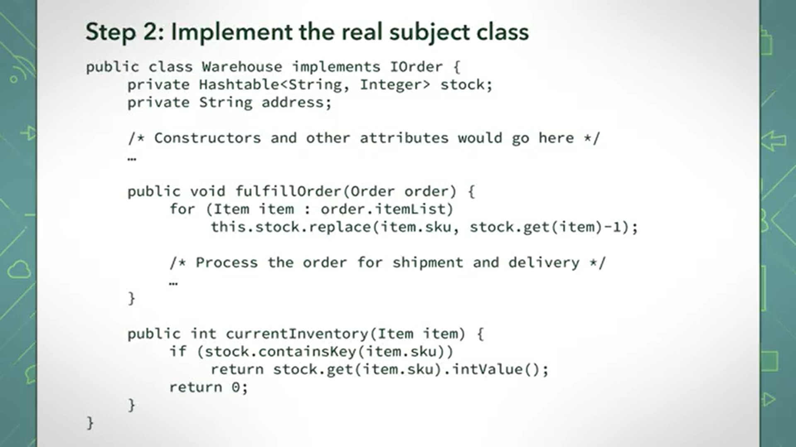

Slide 19
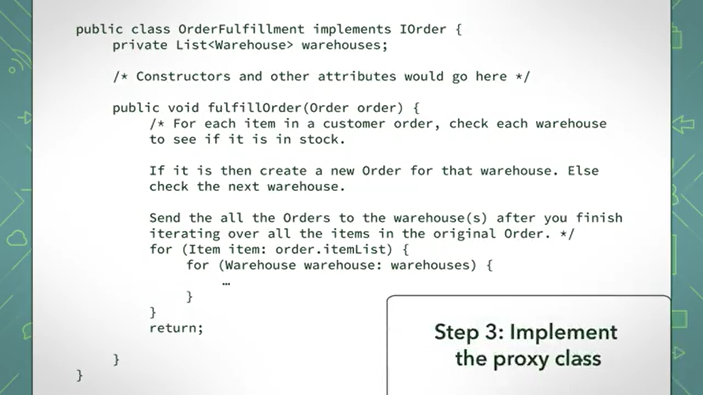

Slide 20
Usage of Proxy Design Pattern
Protect the real subject class
To have a polymorphic design so that the client class can expect the same interface for the proxy and real subject classes,
To use a lightweight proxy in place of a resource intensive object until it is actually needed,
To implement some form of intelligent verification of requests from client code in order to determine if, how, and to whom the requests should be forwarded to
To present a local representation of a system that is not in the same physical or virtual space.
Manages the lifecycle of the service object and proxy will work even if the service object isn’t ready or is not completely available.

Slide 21
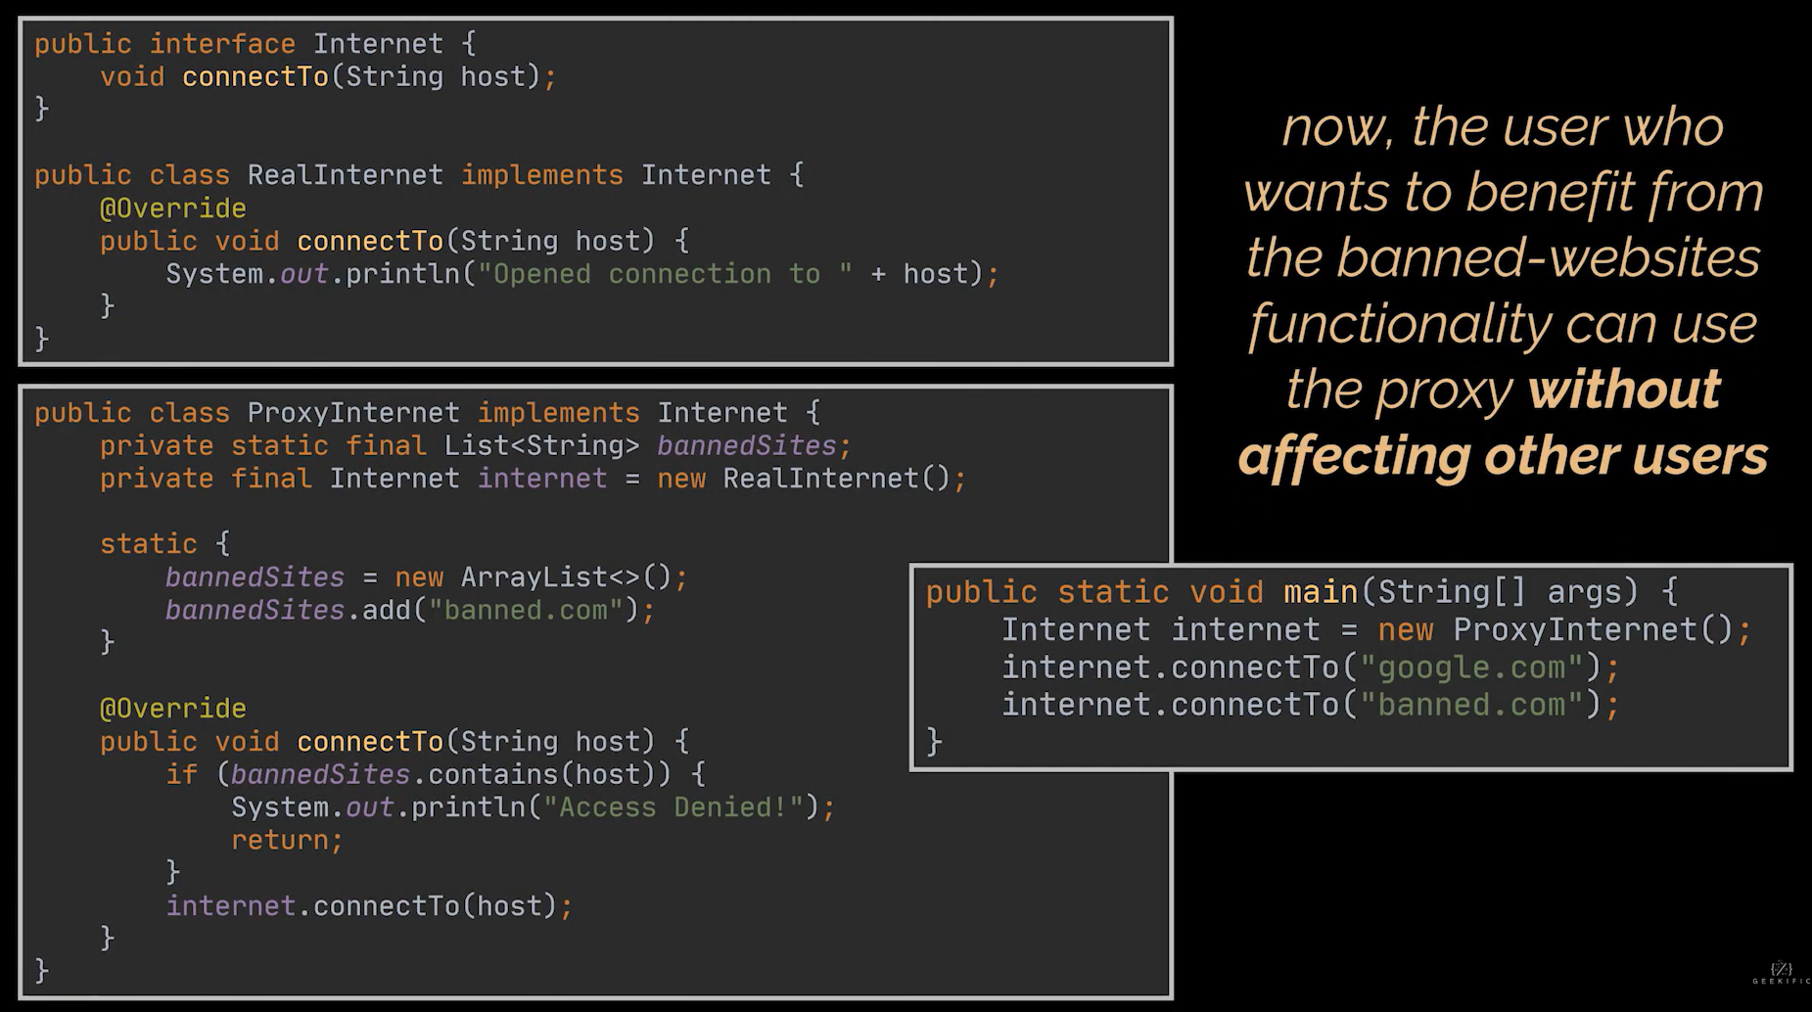

Slide 22
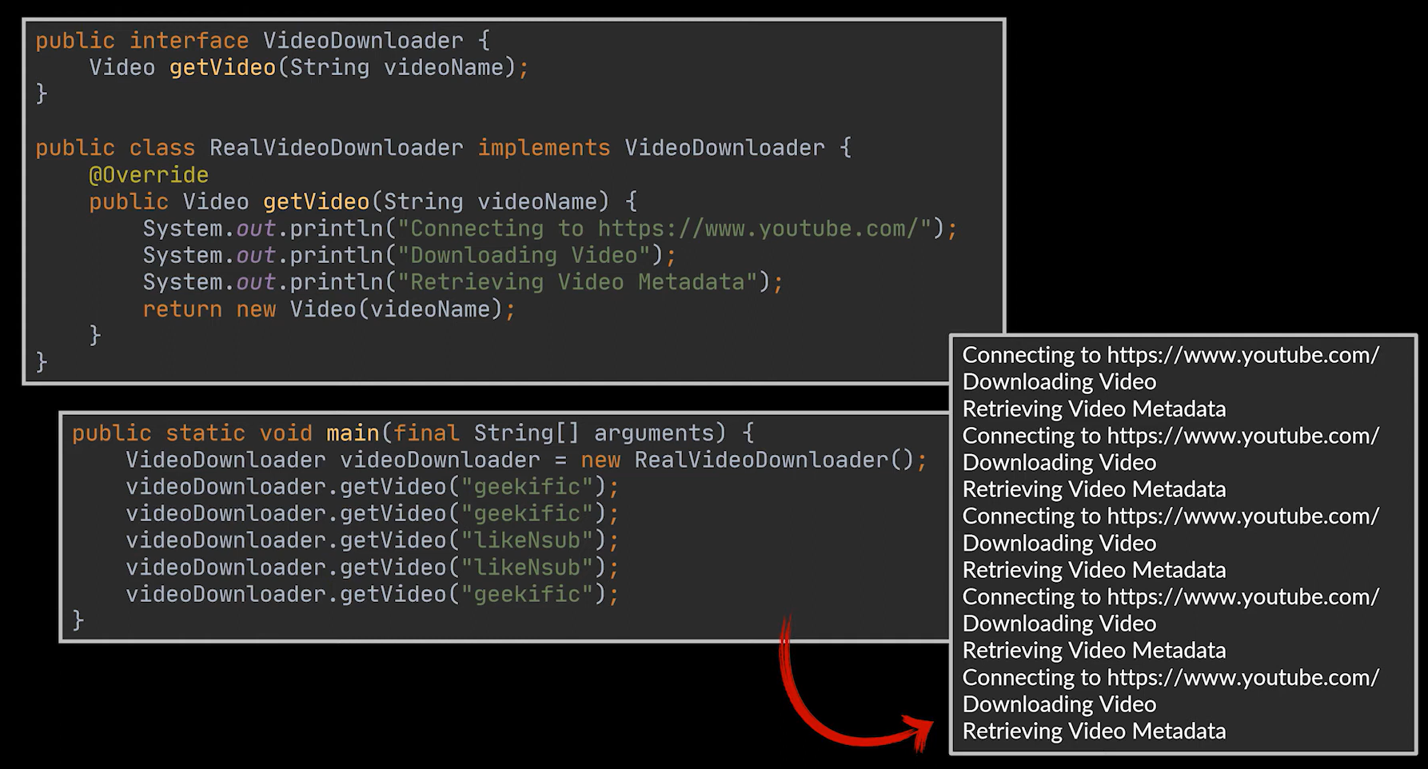

Slide 23
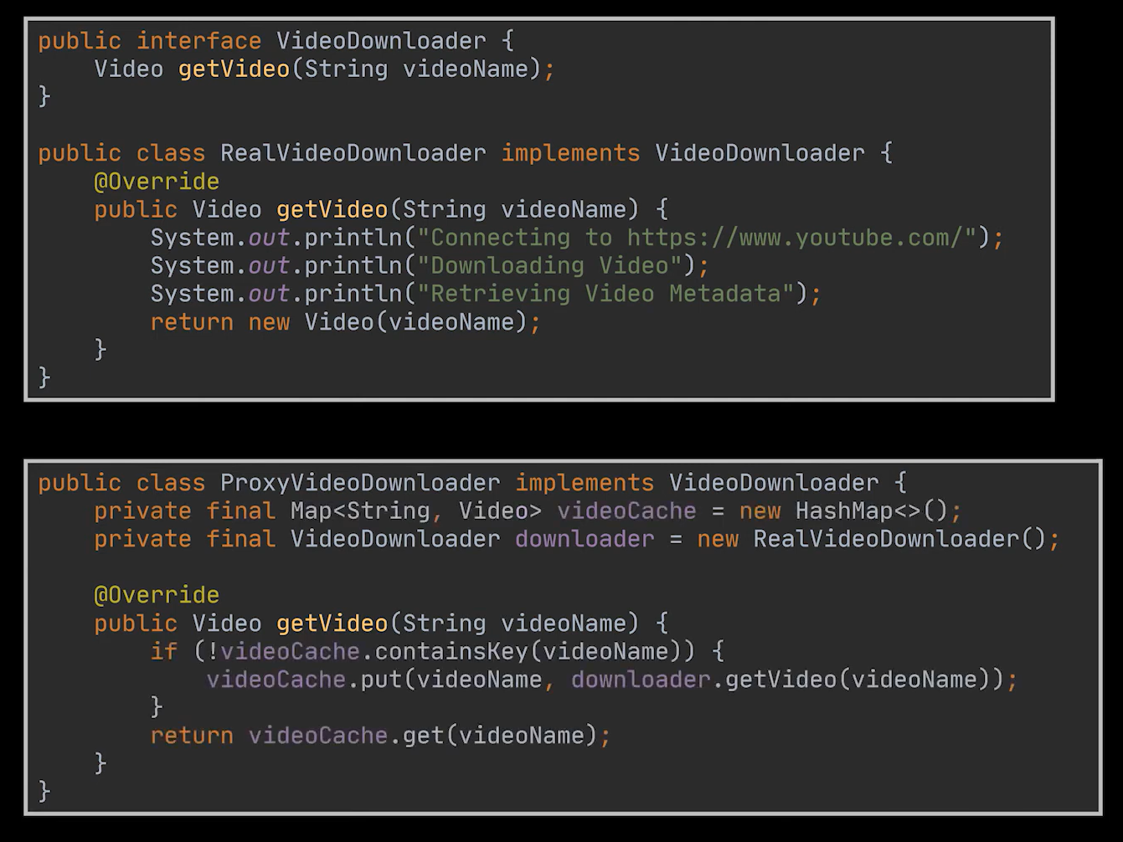

Slide 24
Use cases for Proxy Design Pattern
Type of Proxy | Real-World Scenarios
Virtual Proxy | Image viewer apps (load images on demand) Document editors (thumbnails before full load)
Remote Proxy | Distributed systems (RMI, CORBA, gRPC) Cloud storage (local object for remote files)
Protection Proxy | Banking systems (control access to transactions) Enterprise apps (restrict confidential report access)
Smart Proxy | Caching systems (e.g., CDN edge servers) Database connection pooling
Security Proxy | Firewall servers (monitor/filter traffic) API gateways (authenticate & filter requests)
Monitoring Proxy | Payment gateways (log transactions) Healthcare systems (track patient data access)
Smart Routing Proxy | E-commerce fulfillment (route to correct warehouse) CDNs (route to nearest/fastest server)

Slide 25
Reflective Questions
Why is it important that both the Proxy and Real Subject implement the same interface in the Proxy design pattern?
How does the Proxy pattern improve flexibility and security when interacting with real objects?
In what scenarios might using a Proxy add unnecessary overhead instead of benefits?

